Slide 1
EVALUATION OF LV SYSTOLIC FUNCTION
DR.VIGNESH
SENIOR RESIDENT
DEPT OF CARDIOLOGY
Notes:
SYSTOLE IS A GREEK WORD MEANING CONTRACTION
PHYSIOLOGIC SYSTOLE FROM START OF IVCT TO THE PEAK OF EJECTION PHASE
CARDIOLOGIC SYSTOLE INTERVAL BETWEEN M1 TO A2 DEMARCATED BY HS RATHER THAN PHYSIOLOGIC EVENTS

Slide 3
THE PROGRESS
LINEAR MEASUREMENTS
2D ECHO
DOPPLER
3D ECHO
TDI AND SPECKLE TRACKING
Notes:
LINEAR-LVID IN SYSTOLE AND DISATOLE
2D- LINEAR MEASUREMENTS REPLACED BY AREA AND VOLUME
DOPPLER-INFO ON SYSOLIC FLOW RELATED TO LV FN
TDI AND SPEKLE- MORE DETAILED ANALYSIS OF LV FN

Slide 4
EJECTION FRACTION
EJECTION FRACTION-PERCENTAGE OF LV DIASTOLIC VOLUME THAT IS EJECTED WITH SYSTOLE
EF=STROKE VOLUME/EDV=EDV-ESV/EDV
NORMAL | MILD LV DYSFUNCTION | MODERATE LV DYSFUNCTION | SEVERE LV DYSFUNCTION
EF >55% | 45 – 54% | 30 – 44 % | <30%
Notes:
Accurate-Easy-Reproducible-Simple-
Relatively independent of LV geometry

Slide 5
LINEAR MEASUREMENTS
- M MODE& 2D

Slide 6
FIRST ATTEMPT TO QUANTIFY LV FN
EVALUATION DONE ONLY ALONG A SINGLE INTERROGATION LINE
NML GEOMETRY AND SYMMETRIC FN → ADEQUATELY ASSESSED
ACQUIRED DISEASES→ REGIONAL VARIATION→ SUBJECT TO ERROR→ OVER OR UNDER ESTIMATION.
Notes:
INABILITY TO VISULAISE THE ENTIRE LV AND FALSE ESTIMATION OF THE MINOR AXIS DIMENSION
M MODE HAS BEEN REPLACED WITH 2D ECHO(AREA OR VOLUME)

Slide 7
CHAMBER DIMENSIONS
INITIAL - POOR GRAY SCALE DIFF→ “LEADING EDGE TO LEADING EDGE TECHNIQUE” → OVER ESTIMATION OF EF%
RECENT ADVANCED EQUIPMENTS→ ACTUAL TISSUE BLOOD INTERFACE→ BETTER DELINEATED
Notes:
LEADING EDGE → 1-2MM THICKNESS OF ECHOES

Slide 8
VARIOUS LINEAR MEASUREMENTS
LV INTERNAL DIMENSION IN DIASTOLE → LVIDd (mm)
LV INTERNAL DIMENSION IN SYSTOLE → LVIDs (mm)
FRACTIONAL SHORTENING- FS →[LVIDd-LVIDs] / LVIDd (%)
CUBED LV VOLUME IN DIASTOLE → [LVIDd]³ (ml or cm³)
CUBED LV + MYOCARDIAL VOLUME →[IVS+LVIDd+PW]³ (ml or cm³)

Slide 9
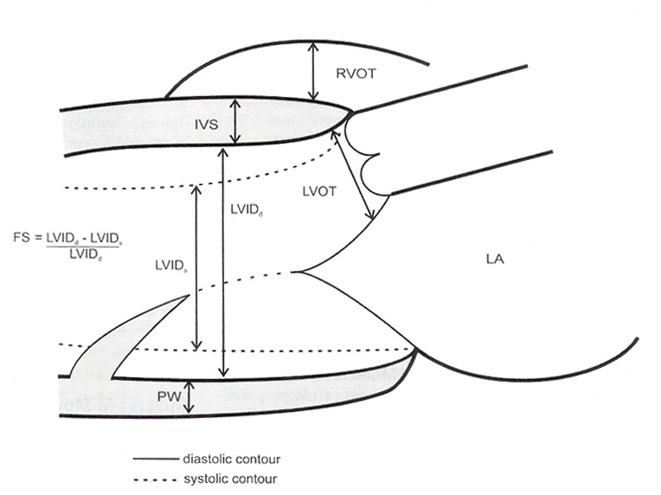
Notes:
Measurement is taken perpendicular to the ventricle at the level of tip of mitral leaflet
Assumes that NO RWMA PRESENT

Slide 11
M MODE
Notes:
PLAX IDEAL WAY @ MV LEAFLET TIPS
END DIASTOLE- frame after MV closure or dimension is largest.
END SYSTOLE - frame preceding MV opening or dimension is smallest
Alternatively, chamber dimension and wall thicknesses can be acquired from PSAX M-mode cursor positioned perpendicular to the septum and LVPW

Slide 12
2D ECHO
LVIDs , LVIDd & WALL THICKNESSES - MEASURED AT MITRAL CHORDAE LEVEL
2D MINOR-AXIS DIMENSIONS SMALLER THAN M-MODE MEASUREMENTS

Slide 13
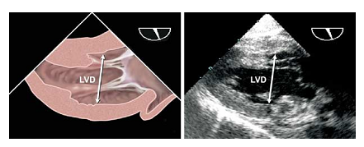
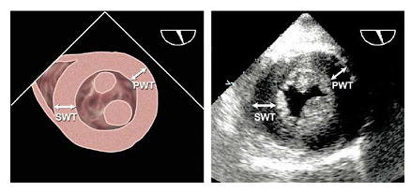
LV MEASUREMENTS - TEE
a) ME-LAX
b)TG-LAX
c) TG –SAX preferred view
Notes:
Recommended TEE views for chamber dimension midesophageal &Transgastric
LV diameters are measured from the endocardium of the AW to the endocardium of the IW in a line perpendicular to the long axis of the
ventricle at the junction of the basal and middle thirds of the long axis.
FOR LV WALL THICKNESS - transgastric midshort-axis view

Slide 14
MODIFIED QUINONES METHOD
MEASURE LVIDd & LVIDs→ CALCULATE RADIAL EF
ADD FACTOR FOR LONGITUDINAL SHORTENING

Slide 15
FRACTIONAL SHORTENIING
→[LVIDd-LVIDs] / LVIDd (%)

Slide 16
LIMITATIONS
WHERE THE MEASUREMENT IS MADE
SEGMENT WITH RWMA → UNDERESTIMATES THE ACTUAL EF%
SEGMENT WITHOUT RWMA → OVERESTIMATES EF%
BEAM ANGULATION
TANGENTIAL BEAM OVER ESTIMATES THE TRUE MINOR AXIS DIMENSION BY 6 TO 12MM
DISCREPANCY BECOMES GREATER WITH AGE AND ANGULATION OF THE HEART

Slide 18
RARELY USED OLDER M MODE TECHNIQUES
RATE OF SYSTOLIC WALL THICKENING OF POST WALL
VELOCITY OF CIRCUMFERENTIAL SHOTENING-VCf
= [LVIDd- LVIDs] / [LVIDd * ET] (circumference/sec)
RATE OF CHANGE OF CIRCUMFERENCE IN MINOR AXIS STANDARDIZED TO HEART RATE
DESCENT OF THE BASE
IN GLOBAL LV DYSFN – MAGNITUDE OF THE MOTION DIRECTLY PROPORTIONAL TO LV SYSTOLIC FN
<10MM → SYSTOLIC DYSFN
Notes:
LV ASSUMED AS A CIRCLE

Slide 19
Notes:
M MODE CURSOR FROM APEX TO THE LATERAL ANNULUS OF MV
16MM MOTION TOWARDDS THE APEX IN SYSTOLE
IN SEV LV DYSFN ANNULAR MOTION <10MM

Slide 20
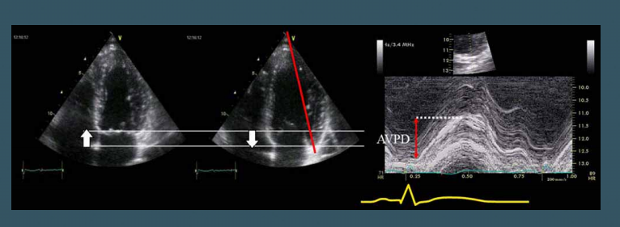
MITRAL ANNULAR PLANE EXCURSION
IF <8MM –
98% SENSITIVE &
82% SPECIFIC
FOR AN EJECTION FRACTION <50%

Slide 21
INDIRECT M MODE MARKERS

Slide 22
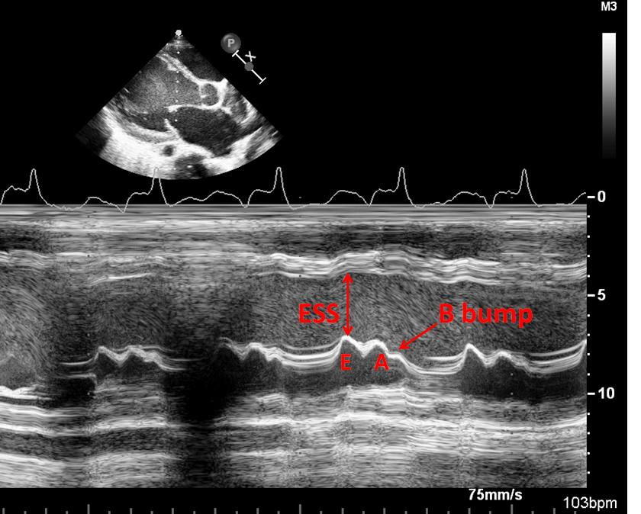
B BUMP
B BUMP
INTERRUPTED CLOSURE OF MV
S/O ELEVATED LVEDP USUALLY >20MMHG
LIMITATIONS
LOW SENSITIVITY
FALSE POSITIVE WITH FIRST DEGREE AV BLOCK & LBBB

Slide 23
EPSS- E POINT SEPTAL SEPERATION
NML <6MM
INCREASED EPSS → S/O SYSTOLIC DYSFN

Slide 24
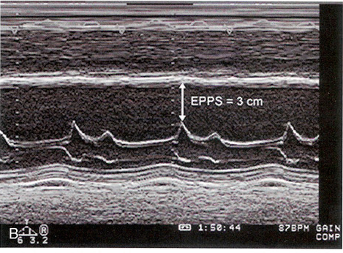
EPSS
NORMAL | ≤6mm | SENSITIVITY | SPECIFICITY
EF<50% | >7mm | 87% | 75%
EF≤35% | ≥13mm | 87% | 84%
LIMITATIONS
INACCURATE
AR
MS
IWMI
Notes:
1)With lv dysfunction-ant→as lv dilates SEPTUM DISPLACED MORE ANTERIORLY
2)reduced opening of MV bcos of decreased transmitral flow into LV

Slide 25
GRADUAL CLOSURE OF AORTIC VALVE
ROUNDED APPEARANCE IN LATER SYSTOLE
DECREASED FORWARD FLOW
S/O LV DYSFN

Slide 28
AREA & VOLUME BASED MEASUREMENTS
2D ECHO
Notes:
2D ECHO SUPERIOR SPATIAL RESOLUTION FOR DETERMINIG LV SIZE AND FN

Slide 29
2D AREA & VOLUME BASED MEASUREMENTS
SHORT AXIS DIASTOLIC AREA(at mid LV)
SHORT AXIS SYSTOLIC AREA(at mid LV)
FRACTIONAL AREA CHANGE
4C LV AREA IN DIASTOLE
4C LV AREA IN SYSTOLE
LV VOLUME IN DIASTOLE
LV VOLUME IN SYSTOLE
STROKE VOLUME
EJECTION FRACTION

Slide 30
FRACTIONAL AREA CHANGE - FAC
SAX VIEW @ MID VENTRICULAR LEVEL
[DIASTOLIC AREA-SYSTOLIC AREA] / DIATSOLIC AREA
REFLECTS THE ACTUAL LV FN IN A SYMMETRICALLY CONTRACTING VENTRICLE
LIMITATION IS THAT ASSESSES THE LV ONLY @ THE LEVEL OF INTERROGATION

Slide 31
VOLUME BASED
APICAL IMAGES IN DIASTOLE AND SYSTOLE
FORMULAS
→ WORK ONLY IN A SYMMETRICALLY CONTRACTING LV
AREA LENGTH FORMULA
TRUNCATED ELIPSE FORMULA

Slide 32
OLD AND SIMPLE METHOD
DETERMINE THE MINOR AXIS DIMENSION
IN DIASTOLE AND SYSTOLE
@ BASE, MID AND DISTAL LV
EF% VALUES ARE COMIBINED AND AVERAGED + QUALITATIVE VISUAL ASSESMENT OF APICAL FN(-5% to +15%)
GOOD CORRELATION WITH STANDARD METHODS

Slide 33
SIMPSON`S RULE OF DISKS
MC METHOD
A4C OR A2C OR BOTH
NO RIGID GEOMETRIC ASSUMPTIONS
MORE ACCURATE
ENDOCARDIAL BORDERS OUTLINED IN END SYSTOLE AND END DIASTOLE
PRINCIPLE
LV DIVIDED INTO INDIVIDUAL DISCS ALONG THE LONG AXIS
INDIVIDUAL DISK VOLUME(AREA *HT OF DISC) @ THAT LEVEL CALCULATED AND SUMMATED TO GET THE TOTAL LV VOLUME
Notes:
ONCE EDV AND ESV CALCULATED THE DIFFERENCE WILL GIVE THE STROKE VOLUME
EF=SV/EDV

Slide 34
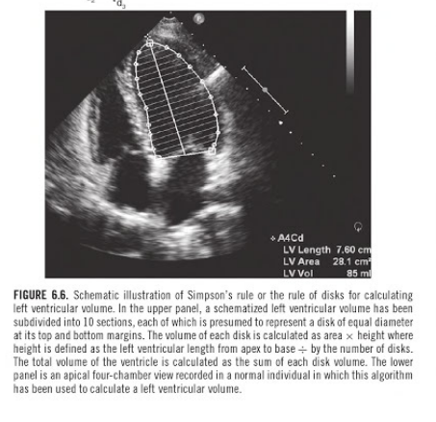
Notes:
HT OF DISC→fraction of the LV long axis
CSA→diameters GOT FROM A2C & A4C

Slide 35
Notes:
VOLUME OF CYLINDER= PI*R²H
SINGLE DISC VOLUME=PI*D^{2*}L/4N

Slide 36
ADVANTAGES
SIMPSON`S METHOD OF DISCS IS A BETTER TECHNIQUE IN THE PRESENCE OF RWMA
RECOMMENDED BY AMERICAN SOCIETY OF ECHOCARDIOGRAPHY

Slide 37
Simpson’s- HOW DO U DO IT ?

Slide 38
BIPLANE METHOD

Slide 39
LIMITATIONS
FOR ACCURACY→ TRANSDUCER MUST BE @TRUE LV APEX AND BEAM SHOULD BE THROUGH THE CENTER OF LV
FORESHORTENING OF LV APEX WILL UNDERESTIMATE LV VOLUME
DIFFICULTY IN EXCLUDING PAPILLARY MUSCLES AND TRABECULAE
LV VOLUME→FREQUENTLY UNDERESTIMATED ESP IN SYSTOLE→ OVER ESTIMATION OF EF%
IN PRESENCE OF SEVERE WMA, SINGLE PLANE METHOD → LOWER SENSITIVITY FOR ESTIMATING EF%
Notes:
ERROR→MOTION OF HEART
A PROPERLY RECORDER A4C VIEW IS THE ONE WITH GREATEST LONG AXIS DIMENSION

Slide 40
WHITE LINE→ TRUE INNER ENDOCARDIAL BORDER
YELLOW LINE→EXCLUDES PAPILLARY MUSCLES INCLUDES APICAL TRABECULATIONS
RED LINE→EXCLUDES THE PAPILLARY MUSCLE TIP

Slide 41
LATEST ECHO MACHINES→ AUTOMATICALLY TRACKED ENDOCARDIAL BORDERS
USUALLY INCLUDES TRABECULATIONS
SO ONLY MINIMAL MANIPULATION NEEDED TO IDENTIFY LV CAVITY BOUNDARY

Slide 42
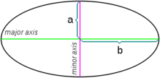
TEICHOLZ /CUBED FORMULA
LV VOLUME CALCULATION IS BASED ON ASSUMPTION THAT THE LV IS A PROLATE ELLIPSE
BASIC ASSUMPTIONS
LV DILATES ALONG THE MINOR AXIS
LVID = MINOR AXIS OF THE ELLIPSE D1
BOTH MINOR AXIS OF ELLIPSE D1,D2 ARE EQUAL
LENGTH OF MAJOR AXIS IS TWICE THAT OF MINOR AXIS
Notes:
VOLUME OF ELLIPSOID=4/3*PI*R²L

Slide 43
LV VOLUME = (LVID)³
MODIFIED TEICHOLZ FORMULA
AS LV BECOMES MORE SPHERICAL AS IT DILATES THE RELATION BETWEEN MAJOR AND MINOR AXIS CHANGES.
THEREFORE A REGRESSION FORMULA WAS DEVISED TO CORRECT FOR THIS CHANGE IN SHAPE
LV VOLUME=( 7.0/2.4+D) X D³

Slide 44
AREA - LENGTH METHOD
HEMI-CYLINDRICAL HEMI-ELLIPSOID MODEL
ASSUMPTIONS:
BASE OF VENTRICLE = CYLINDER
APEX OF VENTRICLE = ELLIPSOID
VOLUME IS CALCULATED USING
LENGTH IN LONG AXIS IN A4C VIEW &
CSA IN SAX VIEW @THE MID-PAPILLARY MUSCLE.

Slide 45
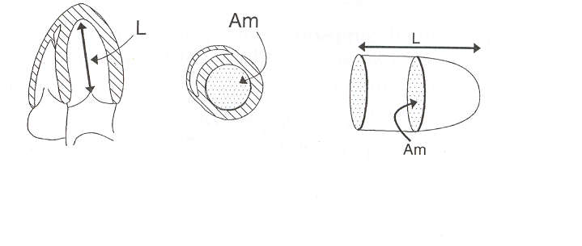
AREA LENGTH METHOD
Notes:
MID LV CSA→ PLANIMETRY IN PSAX view & LENGTH FROM APEX TO MIDPOINT OF MITRAL ANNULUS IN A4C VIEW
DONE IN END SYS AND DIASTOLE
VOLUME IS CALCULATED ACC TO FORMULA

Slide 46
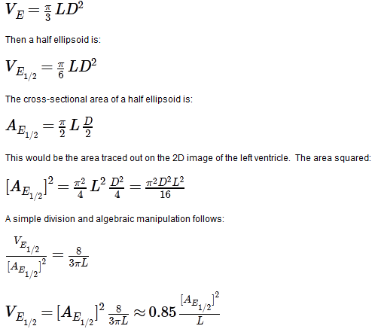
AREA LENGTH METHOD
VOLUME =0.85*[AREA]²/ LENGTH

Slide 47
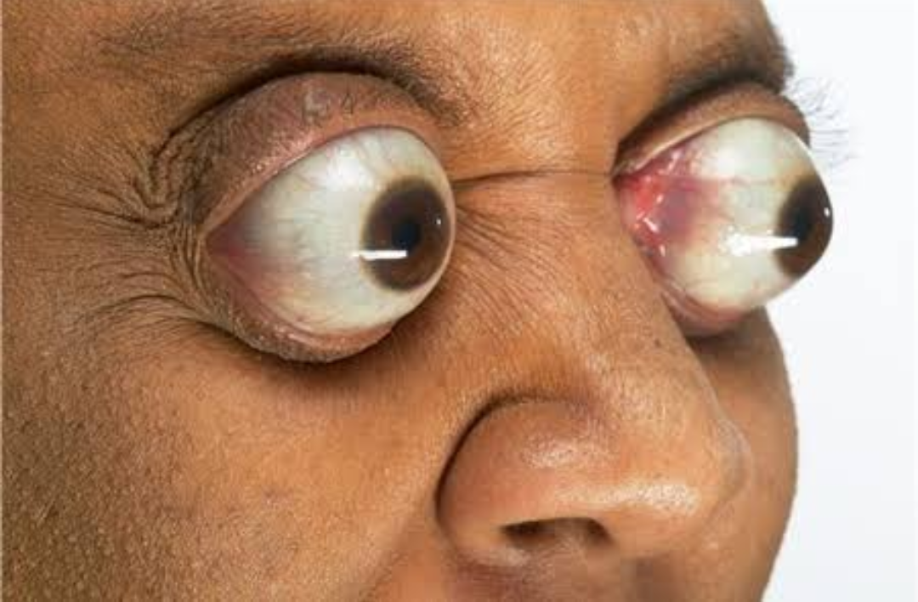
THE EYEBALL METHOD
SUBJECTIVE, VISUAL ASSESMENT OF THE LV
OVERALL SIZE, CONTRACTILITY, INWARD MOVEMENTS AND SYSTOLIC THICKENING
EYES OF AN EXPERIENCED CARDIOLOGIST- BEST METHOD
CORRELATES FAIRLY WELL WITH ANGIOGRAPHIC ASSESSMENT OF THE EF
LIMITATIONS:
IRREGULAR RHYTHM, VERY LARGE OR VERY SMALL LV & EXTREMES OF HEART RATE

Slide 48
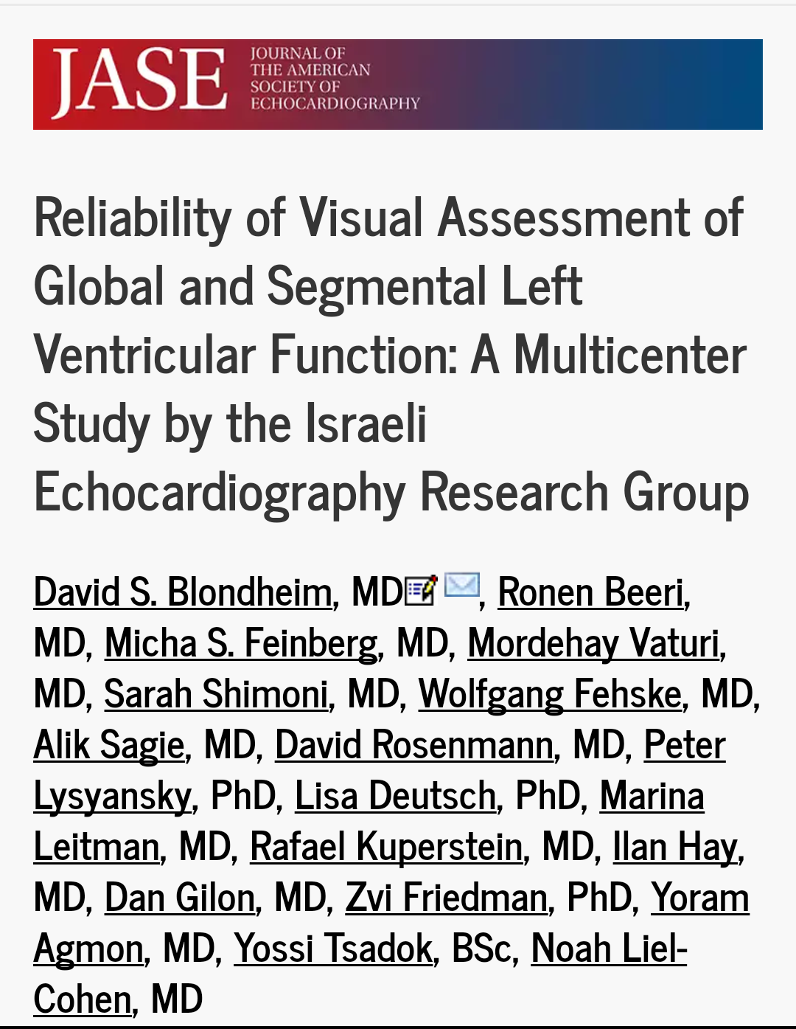
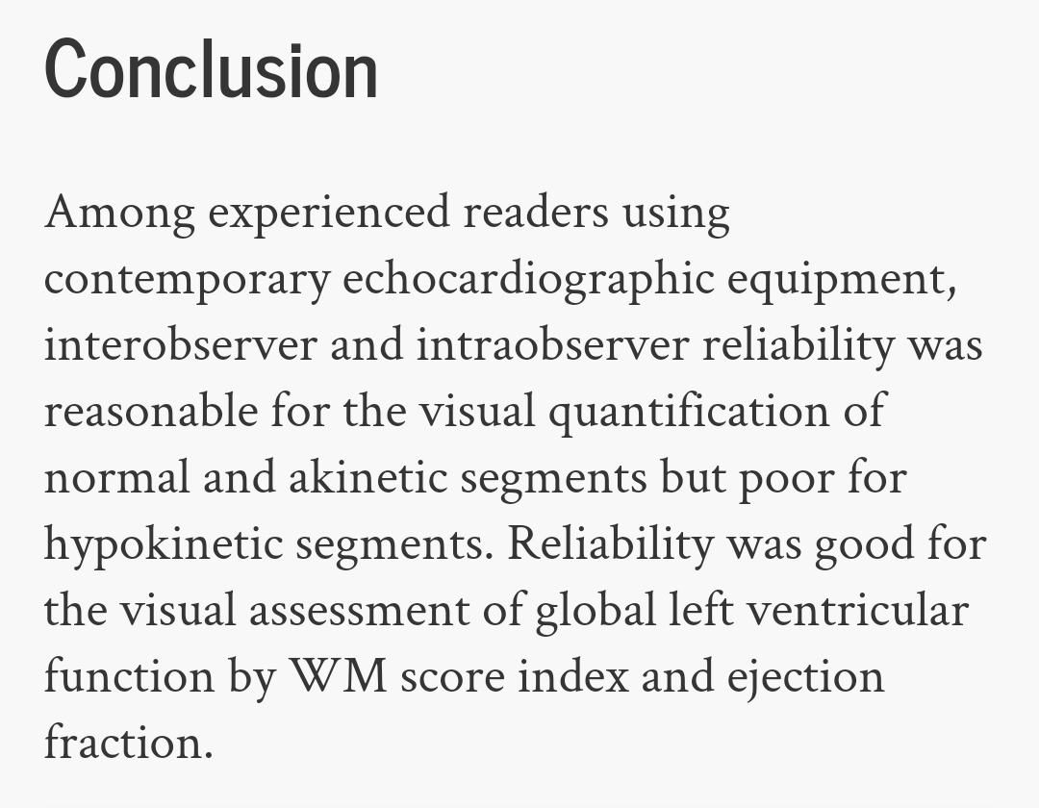
Notes:
2015 JASE
12 DIFFERENT ECHOCARDIOGRAPHERS ON 105 RECORDED ECHOCARDIOGRAMS
RELIABILITY WAS ~80%

Slide 49
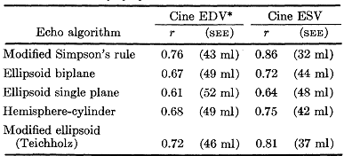
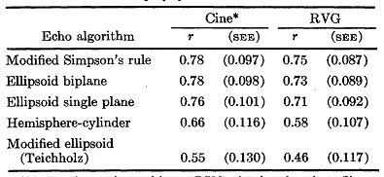
COMPARISION OF VARIOUS ECHO METHODS WITH CINE ANGIO & RADIONUCLIDE VENTRICULOGRAPHY
MODIFIED SIMPSON’S RULE SHOWED MAXIMUM CORRELATION WITH CINE ANGIO & RVG
ESV & EDV CORRELATION
EF CORRELATION

Slide 50
DOPPLER EVALUVATION OF GLOBAL LVFN

Slide 51
ONE OF THE EARLIEST, SIMPLEST AND USEFUL
DOPPLER TO EVALUATE THE TVI OF LVOT OR ASC AORTA
PRINCIPLE:
IF CSA IS KNOWN→ PRODUCT OF CSA & MEAN VELOCITY OF FLOW→ VOLUMETRIC FLOW CAN BE OBTAINED

Slide 52
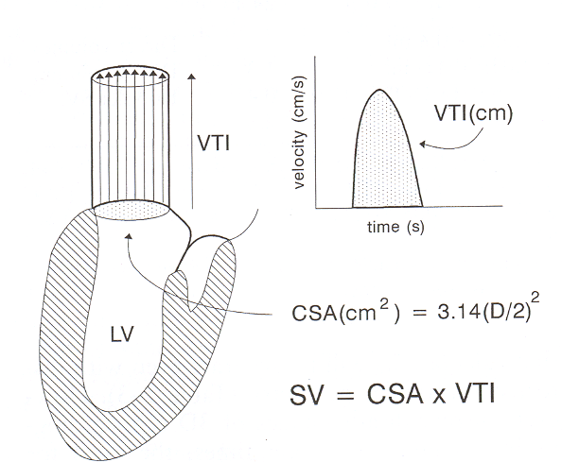
DOPPLER STROKE VOLUME CALCULATION
CARDIAC OUTPUT = STROKE VOLUME X HEART RATE
Notes:
DISCUSSED IN PREV CLASSES

Slide 53
ASSUMPTIONS:
MEASURED CSA IS CIRCULAR
FLOW→ LAMINAR
ANGLE OF INTERCEPTION BETWEEN DOPPLER & BLOOD FLOW→ PARALLEL
VELOCITY & DIAMETER ARE MEASURED @ SAME SITE
THERE IS NO AORTIC REGURGITATION
Notes:
REALITY → ELIPTICAL
FLOW→ PARABOLIC

Slide 54
Notes:
THEORITICALLY MEASURED @ ANY LEVEL MITAL PULMONARY TRICUSPID
SUBSTANTIAL CHANGE IN SIZE & SHAPE OF ANNULUS OVER THE CARDIAC CYCLE→SUBJECT TO ERROR

Slide 55
PROBLEMS WITH DOPPLER
A5C VIEW SOMETIMES DIFFICULT→ A3C MAY BE TRIED
UNDERESTIMATION OF FLOW VELOCITY IF LVOT NOT IN LINE WITH DOPPLER WAVE
A3C MAY BE A BETTER OPTION
PLAX NOT VISUALISED CLEARLY
2CM FOR MALES & 1.75CM FOR FEMALES

Slide 56
LIMITATIONS
CSA MEASUREMENT→ WEAKEST LINK IN THE CALCULATION
MEASURES ONLY FWD FLOW REGURGITANT FRACTION NOT CONSIDERED
FORMULA FOR CSA→ PI (R)²
2MM ERROR IN MEASURING 2OMM DIAMETER OF THE LVOT → 20% APPROX ERROR

Slide 57
MYOCARDIAL PERFORMANCE INDEX TEI INDEX
BOTH LV OR RV
MPI
=( IVCT + IVRT ) / ET
=(TST-ET)/ET
SYSTOLIC DYSFUNCTION
PROLONGATION OF IVCT
SHORTENING OF THE ET
NML RANGE IS 0.39 ± 0.05
VALUES > 0.50 ARE CONSIDERED ABNORMAL

Slide 58
Notes:
PROGRESSIVELY INCREASING MPI WITH WORSENING SYS FN

Slide 59
RATE OF VENTRICULAR PRESSURE RISE (dp/dt)
SPECTRAL PROFILE OF MR JET
TIME DIFF IN MS @VELOCITY 1m/sec AND 3m/sec
AS THE SYSTOLIC FN WORSENS dp/dt DECREASES

Slide 60
DP/DT-Lv function assesment
dp/dt
NML >1200
BORDERLINE 1000-1200
ABNORMAL <1000
dt
1 m/s, 4 mmHg
dP
3 m/s, 36 mmHg
Notes:
BERNOULI EQUN PRESSURE GRDNT= 4(V2-V1)2

Slide 61
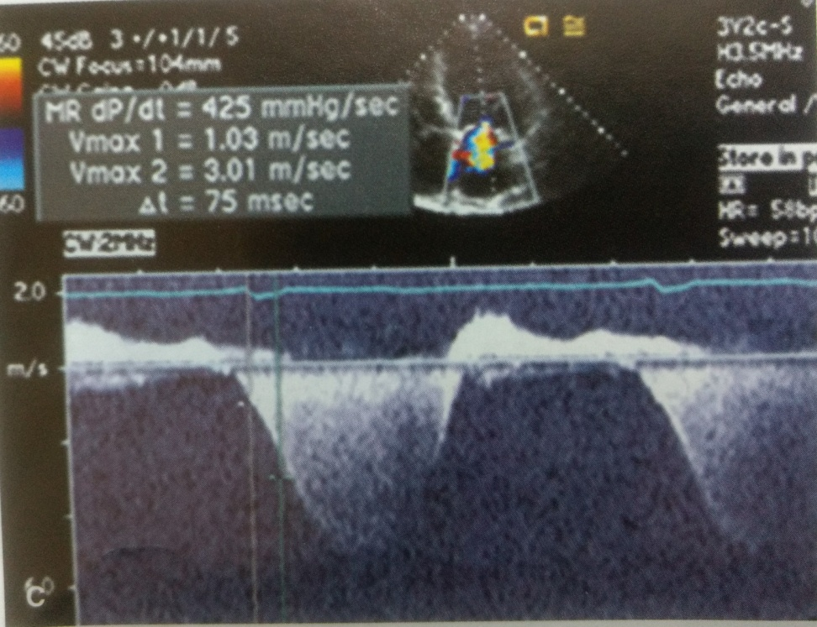
Notes:
PROGRESSIVELY DECREASING DP/DT WITH WORSENING SYS FN

Slide 62
LIMITATIONS
USEFUL ONLY WHEN SIGNIFICANT MR IS PRESENT
COMPLIANCE OF LA IS IMPORTANT
CLICK ARTIFACT OF MV CLOSURE MAY OBSCURE THE DESCENDING LIMB OF MR ENVELOPE
ECCENTRIC MR JETS→ DON’T REFLECT TRUE VELOCITY→ UNDERESTIMATE DP/DT
Notes:
POORLY COMPLIANT LA FALSE HIGH VALUES
HTN AND AS MAY HAVE NML DP/DT WITH IMPAIRED LV FN

Slide 63
OTHER DOPPLER MEASURES
PEAK VELOCITY
MEAN ACCELERATION
ACCELERATION TIME
DECELERATION TIME
EJECTION TIME
MEAN DECELERATION

Slide 64
Evaluation of LV Systolic Function
Ejection Time
Acceleration Time
Deceleration Time
Mean Acceleration
Peak Acceleration
Peak velocity

Slide 65
SYSTOLIC TIME INTERVALS
MC MEASURED INTERVALS ARE
LV PRE EJECTION PERIOD →LVPEP
Q WAVE OF ECG→ONSET OF AV OPENING
LV EJECTION TIME →LVET
AV OPENING TO AV CLOSURE
RATIO OF LVPEP/LVET
SYSTOLIC DYSFN→ PEP IS PROLONGED & ET DECREASED→ INCREASE IN RATIO
Notes:
VERY OLD TECHNIQUE-1968
CAN BE USED AS INDICATORS OF LV PERFORMANCE
VARIATION WITH HR→ LIMITING FACTOR

Slide 66
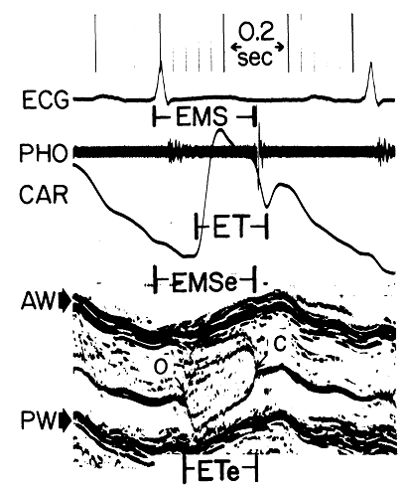
 | LVPEP/LVET | SENSITIVITY | SPECIFICITY
NORMAL (EF>55%) | <0.35 | 24% | 100%
EF<55% | >0.35 | 100% | 72%
EF<30% | >0.65 | 89% | 89%

Slide 67
REGIONAL LV FUNCTION

Slide 68
REGIONAL LV FUNCTION

Slide 69
REGIONAL LV FUNCTION

Slide 70
WMSI

Slide 72
NON ISCHAEMIC RWMA
Notes:
BW AWARE!!!

Slide 73
DIFF ISCHEMIC VS NONISCHEMIC

Slide 74
LBBB

Slide 75
3D ECHO

Slide 76
PROVIDES DETAILED ANATOMIC RELATIONSHIP
MORE ACCURATE LV VOLUME MEASURES
AVOIDS GEOMETRIC ASSUMPTION
MORE REPRODUCIBLE & RELIABLE
SEMI AUTOMATIC EDGE DETECTION ALGORITHMS
Notes:
ADV→ GREATEST IN AN IRREGULARLY SHAPED VENTRICLE

Slide 77
3D echo

Slide 78
Notes:
3D RECORDING OF DCM PT EF 34%
INSTANTANEOUS VOLUME CHANGE IN EACH OF 17 SEGMENTS

Slide 79
Notes:
ONCE ACQUIRED CAN BE FURTHER SUBDVIDED INTO 17 SEGMENT BULL`S EYE MODEL

Slide 80
TISSUE DOPPLER IMAGING & SPEECKLE TRACKING

Slide 81
TISSUE DOPPLER
SPECKLE TRACKING
RELIES ON ADJUSTMENT OF DOPPLER GAINS & FILTERS
SELECTIVE RECORDING OF VELOCITIES FROM MYOCARDIUM ITSELF RATHER THAN THE BLOOD POOL
PRIMARY INFO EXTRACTED→ TISSUE VELOCITY→ DISPLACEMENT→ STRAIN & RATE DERIVED
IDENTIFICATION OF UNIQUE MYOCARDIAL ULTRASOUND SIGNATURES WHICH CAN BE TRACKED
PRIMARY INFO EXTRACTED→ TISSUE DISPLACEMENT→ STRAIN & STRAIN RATE DERIVED
Notes:
WITH BOTH TECHNIQUES→ MULTIPLE REGIONS→TRACKED SIMULTANEOUSLY
ALGORITHMS→ APPLIED TO 3D DATA→LV PERFORMANCE PARAMETERS DERIVED

Slide 82
DOPPLER BASED→ ANGLE DEPENDENT & HIGH TEMPORAL RESOLN
INITIAL CONCEPT
COLOUR CODING→DIRECTION & VELOCITY OF WALL MOTION→ VALUABLE ANALYSIS
SIGNAL NOISE RATIO & FRAME RATE→NOT OPTIMAL AS A STAND ALONE TECHNIQUE

Slide 83
PHASIC COLOUR CHANGE WITH MOTION EASILY APPRECIATED
COLOUR DOPPLER M MODE CAN ALSO BE USED
SEPTAL MOTION OF LBBB→ CLEARLY SEEN
ANNULAR SYSTOLIC VELOCITY→ MARKER OF GLOBAL LV SYSTOLIC FN
Notes:
ANNULAR VELOCITY DATA→ MAJOR ROLE IN DIASTOLIC FN

Slide 84
Notes:
RED TOWARDS TRANDUCER
BLUE AWAY

Slide 86
Notes:
TDI @ LATERAL ANNULUS IN 2 PTS
UPPER PANEL→ PT WITH NML LV FN & EF 60%
LOWER PANEL→PT OF DCM & EF 27%

Slide 87
STRAIN & STRAIN RATE IMAGING
Notes:
MAJOR TECH→ANALYSE LV MOTION IN REFERENCE TO THE TRANSDUCER

Slide 88
STRAIN EVALUATES MYOCARDIAL REGION WITH REFERNCE TO ADJACENT MYOCARDIAL SEGMENT
THEORETICALLY MORE ACCURATE DATA
DEFORMATION ANALYSIS
STUDY OF ANALYSIS OF VENTRICULAR MECHANICS & SHAPE DURING CARDIAC CYCLE
MYOCARDIAL STRAIN, STRAIN RATE, TORSION
THREE ORTHOGONAL PLANES
LONGITUDINAL, CIRCUMFERENTIAL & RADIAL

Slide 89
STRAIN
DEFINED AS NORMALIZED CHANGE IN LENGTH BETWEEN 2 POINTS
NEGATIVE STRAIN → SEGMENT SHORTENING
POSITIVE STRAIN → SEGMENT LENGTHENING
DERIVED VARIABLE
NML CONTRACTION
NEGATIVE LONGITUDINAL SYSTOLIC STRAIN
BIPHASIC DIASTOLIC STRAIN(EARLY & LATE FILLING)
WALL THICKENING IN SYSTOLE→NML RADIAL STRAIN IS +VE

Slide 90
CALCULATED IN MULTIPLE SEGMENTS
DEPICTED AS A 17 SEGMENT MODEL AS RECOMMENDED BY ASE
NOT UNIFORM AMONG ALL MYOCARDIAL SEGMENTS
BASAL PARAMETERS HIGHER THAN APICAL
STRAIN & STRAIN RATE ARE MORE SENSITIVE & EARLY INDICATORS OF ABNORMAL MYOCARDIAL FN

Slide 91
SIGNIFICANT LIMITATION IS THE HETEROGENEITY OF NML VALUES
WITHIN THE MYOCARDIUM & AS WELL AS PT TO PT→ BROAD RANGE OF NML VALUES
REPRODUCIBILITY OF THESE NOT CONFIRMED IN LARGE POPULATIONS
SUBTLE DEVIATIONS FROM NML SHOULD BE INTERPRETTED IN CLINICAL CONTEXT
SERIAL CHANGES IN SAME PT TO BE GIVEN MORE IMPORTANCE

Slide 92
STRAIN CLEARLY DETECTS MYOCARDIAL CONTRACTION ABNORMALITIES NOT APPARENT VISUALLY
SHOWN PROMISE AS A MARKER OF PRECLINICAL DISEASE IN NO OF CONDITIONS

Slide 93
SYSTEMIC DISEASE
HTN, DM, AMYLOID & STORAGE DISORDERS
PRIMARY MYOCARDIAL DISEASE
HCM, DCM ADRIAMYCIN TOXICITY & POST TRANSPLANT REJECTION
CAD
LOW GRADE ISCHEMIC
HIBERNATION/ STUNNING
STRESS INDUCED ISCHAEMIA

Slide 94
Notes:
LONGITUDINAL AND RADIAL STRAIN RECORDED FROM A4C VIEW IN A NML PERSON WITH EF67%
LONGITUDINAL STRAIN IS NEGATIVE
RADIAL STRAIS POSITIVE

Slide 95
THANK YOU

Slide 96
MCQ
1.WHICH IS THE METHOD RECOMMENDED BY AMERICAN SOCIETY OF ECHOCARDIOGRAPHY FOR EF ESTIMATION?
1) TECHOLZ
2) QUINONES
3) AREA LENGTH
4) SIMPSON’S BIPLANE
Notes:
ANS 4

Slide 97
2.WHICH METHOD CALULATES EF WITH RADIAL EJECTION FRACTION & CORRECTION FOR LONGITUDINAL FACTOR
1) TECHOLZ
2) QUINONES
3) AREA LENGTH
4) SIMPSON’S BIPLANE
Notes:
ANS 2

Slide 98
3.PT IS A CASE OF DCM WITH SEV LV DYSFN HIS EPSS WOULD BE
1)7
2) 11
3)15
4)10
Notes:
Ans 3

Slide 99
4.PREFERRED CHOICE FOR EF ESTIMATION IN PATIENTS WITH GEOMETRICALLY DEFORMED LV
1) TEICHOLZ
2) QUINONES
3) SIMPSONS
4) 3D ECHO
Notes:
Ans 4

Slide 100
5.MITRAL ANNULAR PLANE EXCURSION SUGGESTIVE OF LV DYSFUNCTION
1) 5
2)8
3)10
4)12
Notes:
Ans 1

Slide 101
6.WHAT IS WALL MOTION SCORE FOR DYSKINESIS
a)1
b)2
c)3
d)4
Notes:
Ans D

Slide 103
7.WHAT IS THE NORMAL WALL MOTION SCORE INDEX?
A)2
B)4
C)1
D)3
Notes:
Ans c

Slide 104
8.WHICH METHOD IS KNOWN AS THE D CUBE METHOD
1) QUINONES
2) SIMPSONS
3) AREA LENGTH METHOD
4) TEICHOLZ
Notes:
Ans 4

Slide 105
9.dp/dt OF MR JET IS 1400 THE PT HAS
1) MILD LV DYSFN.
2) SEVERE LV DYSFUNCTION
3) NORMAL LV FUNCTION
4) MODERATE LV DYSFUNCTION
Notes:
ans3

Slide 106
10.ALL OF THESE INDIRECTLY DENOTE LV DYSFUNCTION EXCEPT ?
A) EPSS > 15
B) MAPSE < 8
C) DP/DT< 800
D) MYOCARDIAL PERFORMANCE INDEX < 0.5
Notes:
ANS D

Slide 107
11. WHICH IS KNOWN AS TEI INDEX?
1)CARDIAC INDEX
2) MYOCARDIAL PERFORMANCE INDEX
3) LV PREEJECTION TIME/ LV EJECTION TIME
4)DP/DT OF MR JET
Notes:
Ans 2

Slide 108
12. IN WHICH FORMULA FOR LV FUNCTION ASSESMENT IS THE ASSUMPTION OF PROLATE ELLIPSE CONSIDERED
1) QUINONE’S
2) TEICHOLZ
3) AREA LENGTH
4) SIMPSON’S
Notes:
ANS 2

Slide 109
13.TRANSTHORACIC ECHO IS SUPERIOR TO TRANSESOPHAGEAL ECHO IN
A) ASSESING PROSTHETIC VALVE FUNCTION
B) ASSESS LA CLOT
C) DIAGNOSISOF INFECTIVE ENDOCARDITIS
D) ASSESMENT OF LV SYSTOLIC FUNCTION
Notes:
Ans:D

Slide 110
14. NORMALLY CONTRACTING LV HAS
1.POSITIVE LONGITUDINAL STRAIN
2.NEGATIVE LONGITUDINAL STRAIN
3.NEGATIVE RADIAL STRAIN
4, NONE OF ABOVE
Notes:
ANS 2

Slide 111
15.SYSTOLE IS A ______ WORD
1.LATIN
2.GREEK
3.ENGLISH
4.CHINESE

